Slide 1
Operational Facility INSPECTIONS - NEW OPFAC OFFER FOR USE & EXISTING OPFAC RE-INSPECTION
AUXDATA II
Chris Mather – DSO-IS
Mike Brodey - SO-IS

Slide 2
For re-inspection of an existing facility, start at slide #15 “Re-inspection of Existing Facility - Step 1”
See slide #18 at end for Radio Facility Differences

Slide 3
Step 1 - New Offer For Use (OFU)
Click on “Facilities” from Home page.

Slide 4
Step 2
Click “New”
Then “Boat” or appropriate Facility Type

Slide 5
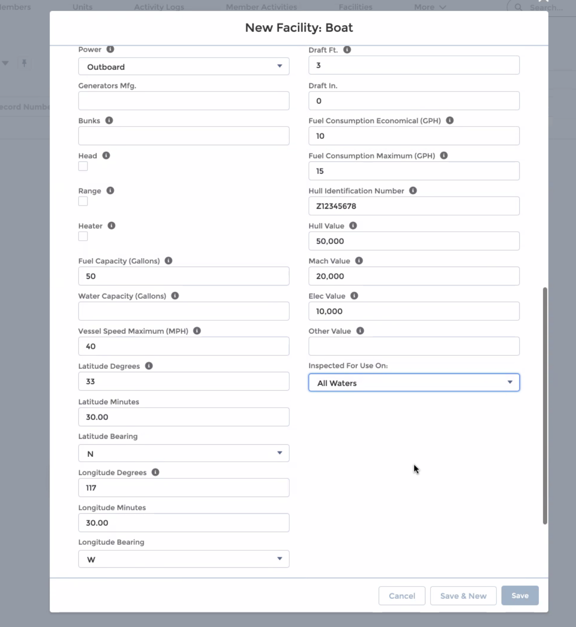
Step 3
Fill in your vessel information.
Scroll down to reveal more fields. It is very important to fill out ALL vessel/Facility information applicable at this time.
Choose from menu
Click “Save” after all applicable info had been entered.

Slide 6
Step 4
Note:
1. New Facility Number assigned
(Make note of number for easy recall.)
2. Status = “New”

Slide 7
Step 5
Choose a “Requested Inspection Date”
Type in a qualified VE into Vessel Examiner Field
Type in current OTO (ESSELMAN) into DIRAUX field.
Leave actual Inspection Date blank at this time.
5. Click “Save”
Robert F DeVoy

Slide 8
Step 6
Click “Submit for Approval”
Note: Clicking “Submit for Approval” sends an email/request to selected Vessel Examiner, and changes status from “New” to ”Under Inspection”

Slide 9
Step 7
Add any appropriate comments, then
Click “Submit”

Slide 10
Step 8
Note:
Status = “Under Inspection” status auto changes from “new” to “Under Inspection” after submit for approval clicked by owner.
Inspection has been assigned to the VE

Slide 11
Vessel Examiner Step 1
To process inspection, Vessel Examiner must log in to their own AUXDATA II account.

Slide 12
Vessel Examiner Step 2
Navigate to Facility Inspection Record Number (ie., FI-23464) - FI number is included with system email to VE.
NOTE: “FI-xxxxx” is a Facility Inspection Record.
”F-xxxxx” is a Facility Record.

Slide 13
Vessel Examiner Step 3
Fill in actual “Inspection Date”
Upload required documents;
Registration
Completed & signed Form 7003
Photos
Click ”Approve” or “Reject”
ENSURE ALL REQUIRED DOCUMENTS AND INFO ARE UPLOADED AND COMPLETE BEFORE CLICKING “APPROVE”

Slide 14
Vessel Examiner Step 4
After clicking ”Approve”, VE checks Status field has changed to “DIRAUX Review”
This places the Facility Inspection with DIRAUX/OTO for final approval.
Example shows 7003 form uploaded. Also need photos and Registration or COD.

Slide 15
Re-inspection of Existing Facility Step 1
Navigate to Your Facility Record Page
Fastest method is to type Facility Record number in Global Search window (ie., F-16795)
Other methods of navigating to record is via Facilities object or owner’s personal Related/Facilities page.
Click Facility Inspections “New” button

Slide 16
Re-inspection of Existing Facility Step 2
Select “Boat” (or as appropriate)
Click “Next”

Slide 17
Re-inspection of Existing Facility Step 3
The system will populate the record with your Facility number (ie: F-16795).
Proceed as shown in New Inspection Step 5 (Slide #7).

Slide 18
Radio Facility Inspection Differences
Facility Inspector must be an active ”CM” officer at any level (ie: FSO-CM, SO-CM, etc).
For HF Radio, Facility Inspector must also own/operate an HF Facility themselves.
HF Radio Approvers at the present time (not required for VHF only Facility)
Type these HF Approvers into fields as shown:
BC-RTI: Donald L Wellons
DVC-RT: David A Elliot

