Slide 1
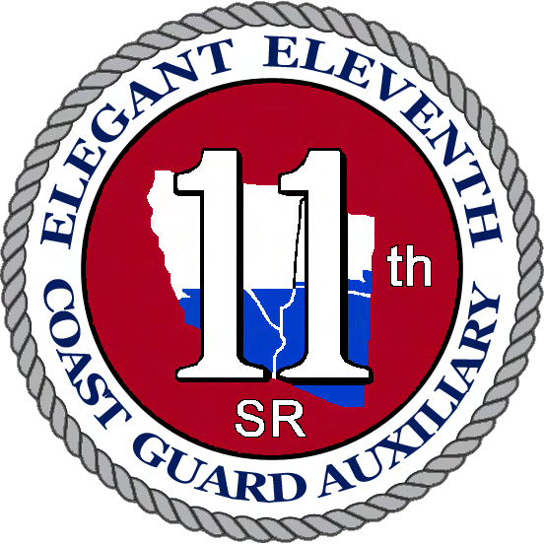
UNITED STATES COAST GUARD AUXILIARY
DISTRICT ELEVEN SOUTHERN REGION

Slide 2
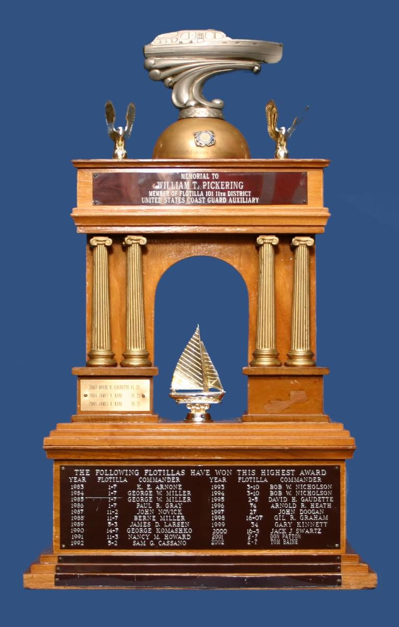
MOST ACTIVE
FLOTILLA
PICKERING AWARD
FLOTILLA 06-03
Orange Coast

Slide 3
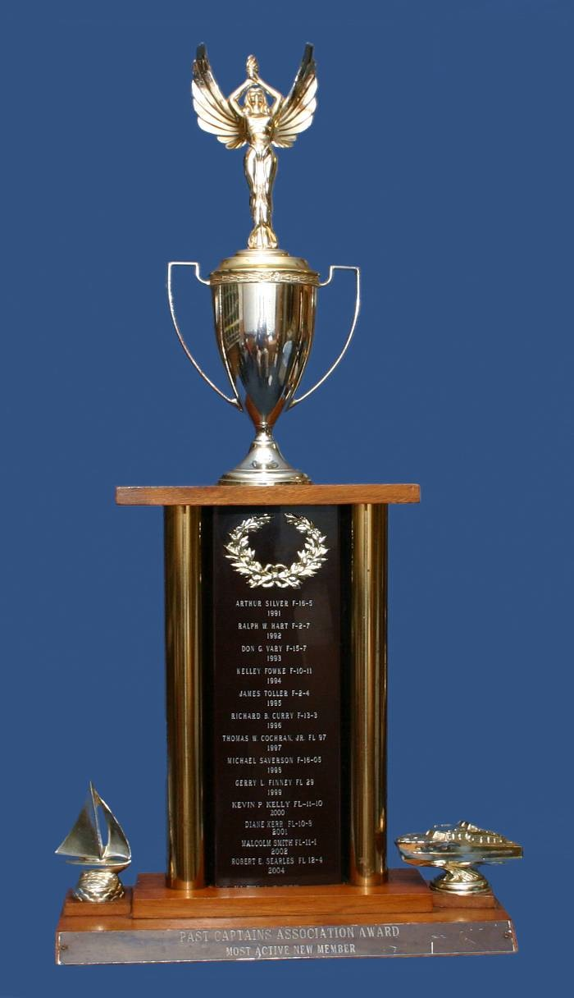
MOST ACTIVE NEW
MEMBER
PAST CAPTAIN'S
ASSOCIATION TROPHY
CURTIS CONNOR
FLOTILLA 09-02
Lake Havasu City

Slide 4
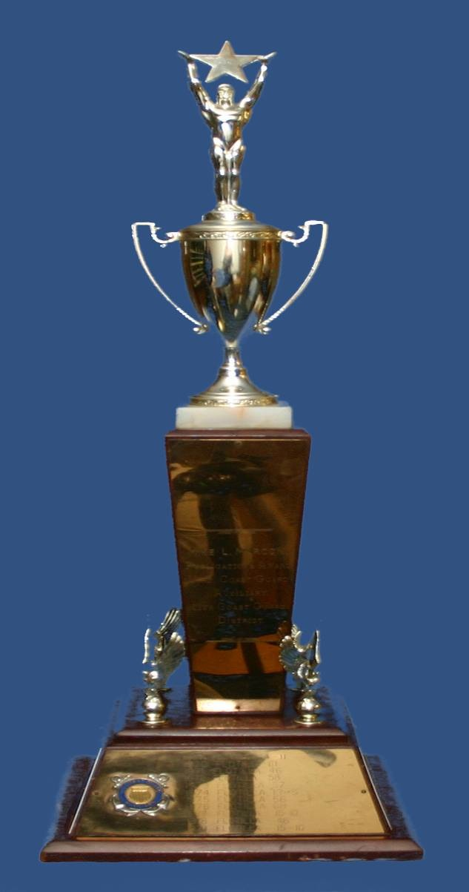
BEST FLOTILLA
PUBLICATION
MIKE MARCONI AWARD
Flotilla 07-02
Channel Islands Harbor

Slide 5
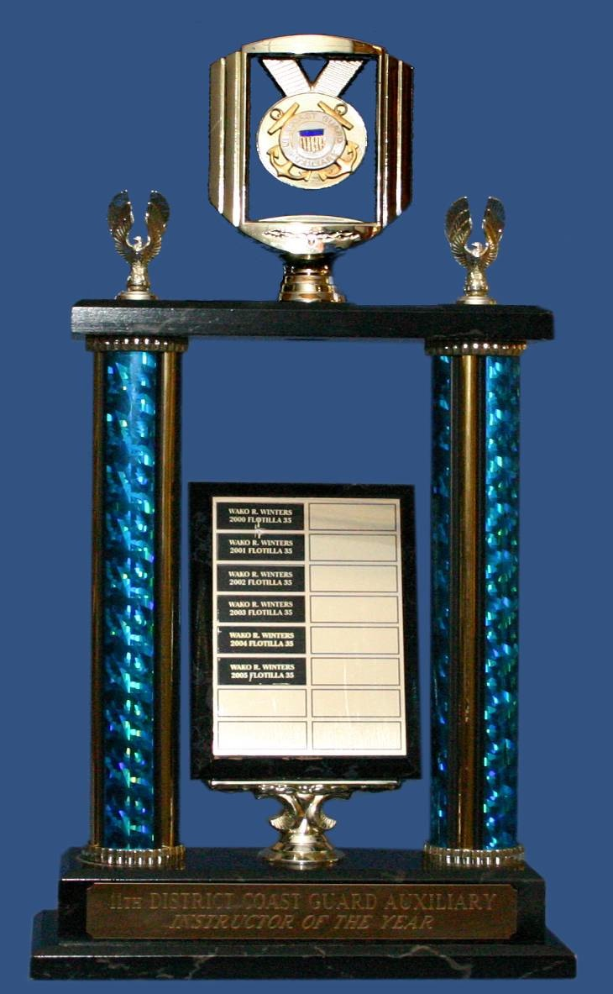
INSTRUCTOR OF THE
YEAR AWARD- PUBLIC EDUCATION
GRANT GRAVES
FLOTILLA 12-04
Los Angeles

Slide 6
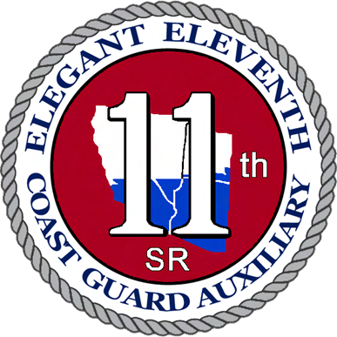
INDIVIDUAL MOST ACTIVE
IN MEMBER TRAINING
WAKO WINTERS
FLOTILLA 05-09
San Pedro- Port of Los Angeles

Slide 7
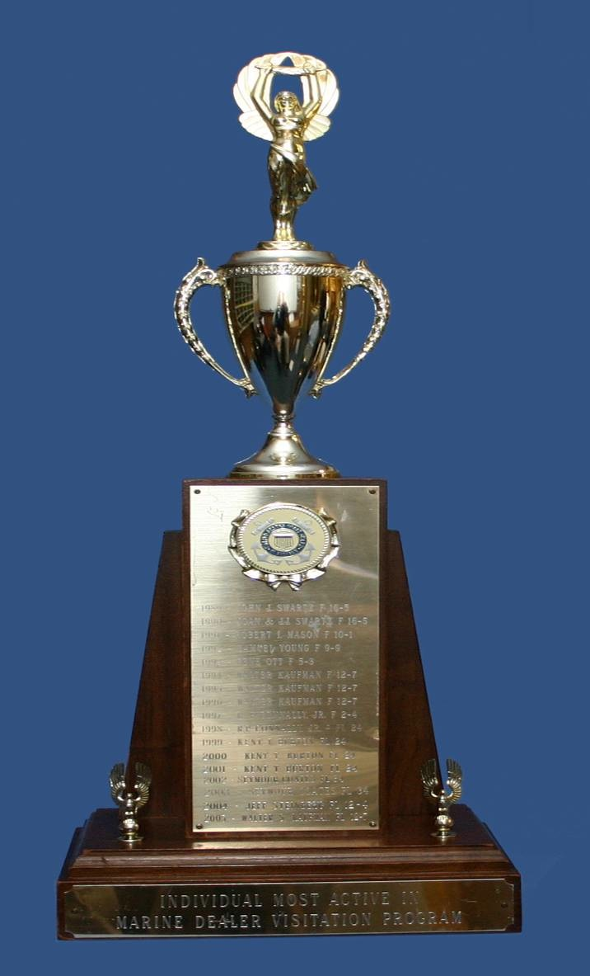
INDIVIDUAL MOST ACTIVE
IN THE RECREATIONAL
BOATING SAFETY
VISITATION PROGRAM
WAYNE PALMER
FLOTILLA 06-07

Slide 8
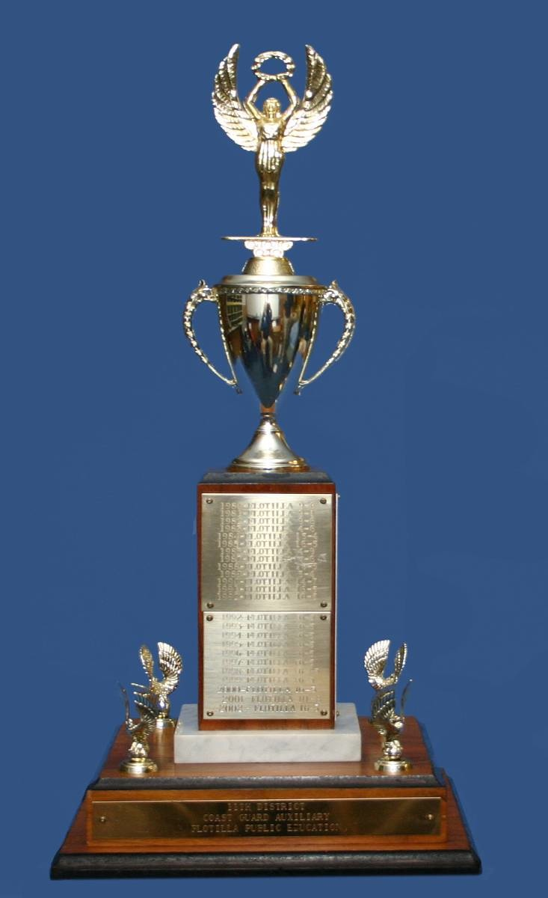
FLOTILLA MOST
ACTIVE IN PUBLIC
EDUCATION
FLOTILLA 12-04
Los Angeles

Slide 9
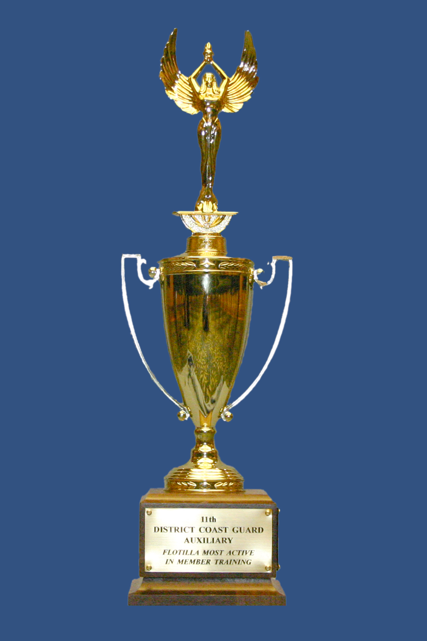
FLOTILLA MOST ACTIVE
IN MEMBER TRAINING
FLOTILLA 05-10
Los Angeles/Long Beach Mariners

Slide 10
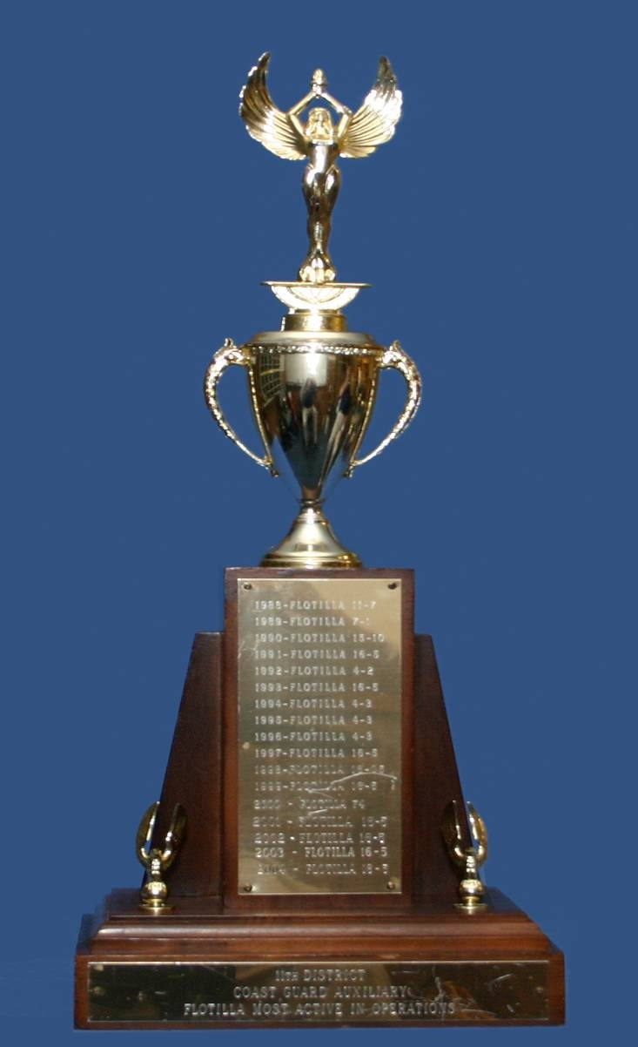
FLOTILLA MOST
ACTIVE IN OPERATIONS
FLOTILLA 07-07
Channel Islands Radio

Slide 11
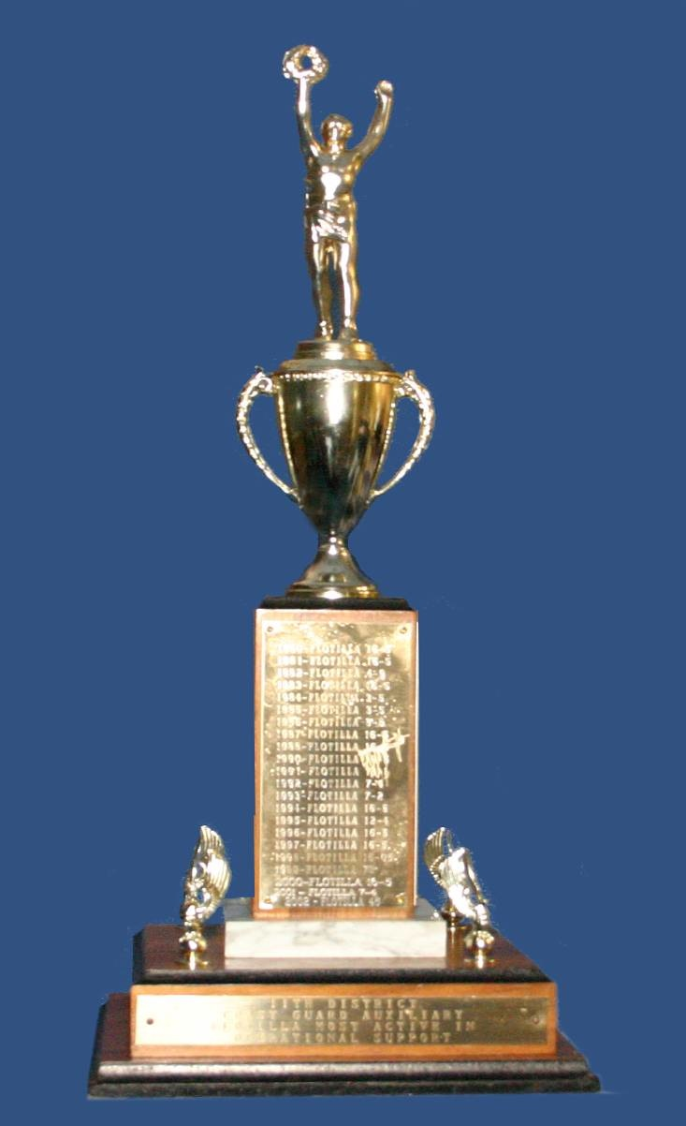
FLOTILLA MOST ACTIVE
IN OPERATIONAL
SUPPORT
FLOTILLA 05-12
Shoreline Marina

Slide 12
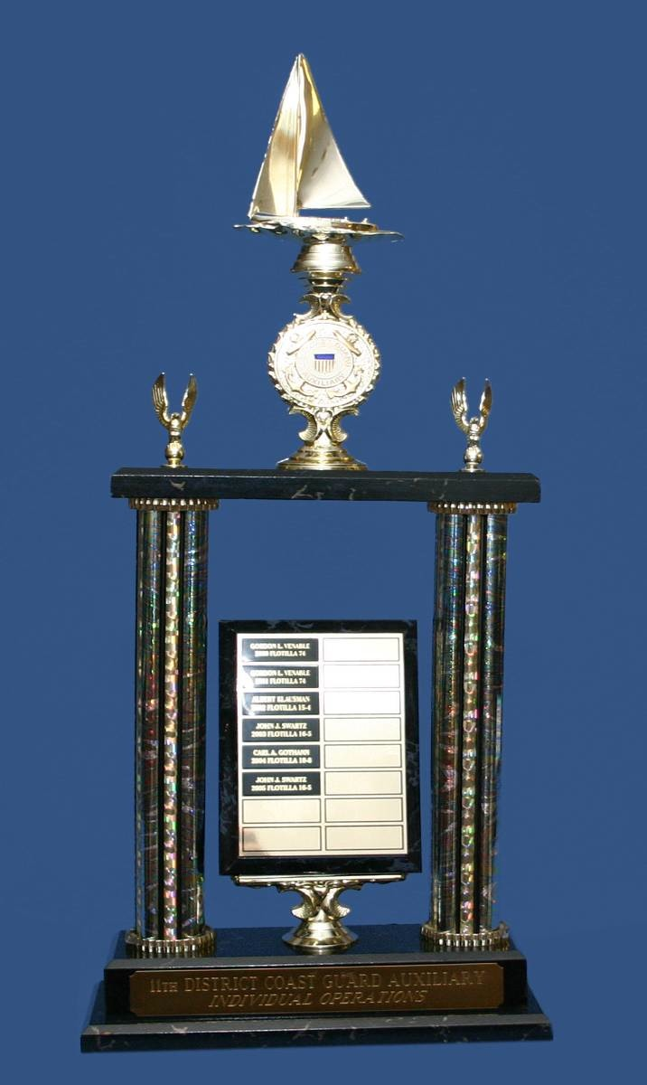
INDIVIDUAL MOST
ACTIVE OPERATIONS
DAVID VADBUNKER
FLOTILLA 07-07
Channel Islands Radio

Slide 13
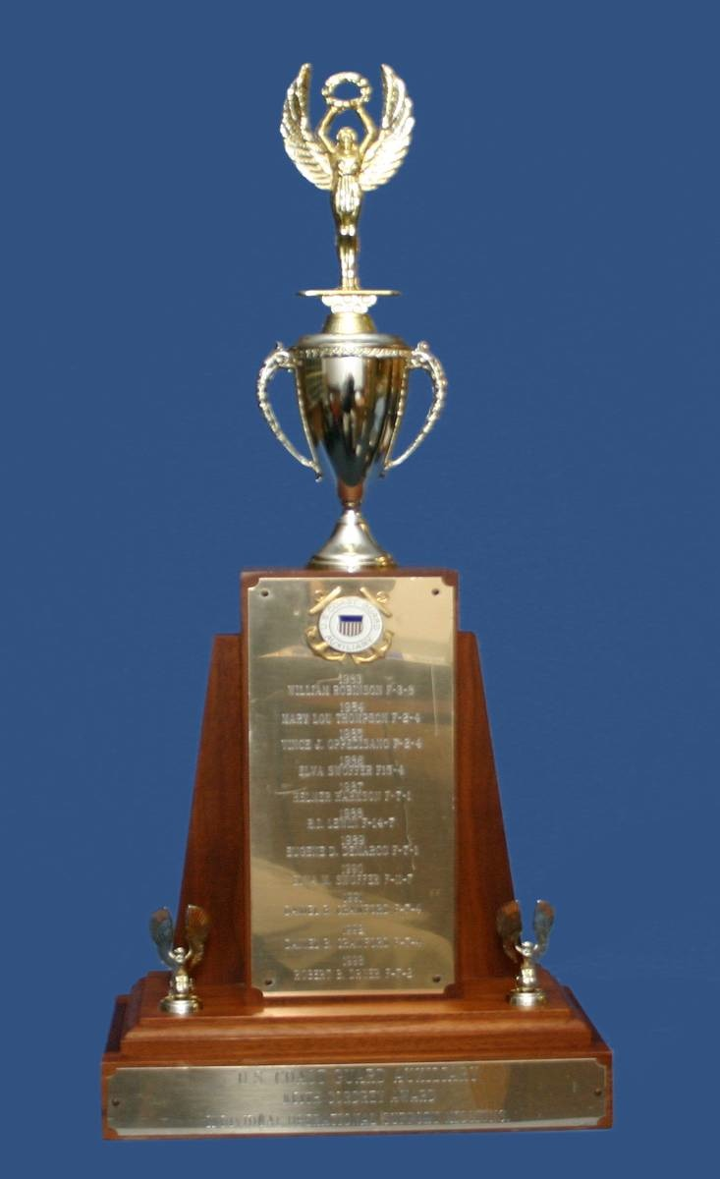
INDIVIDUAL MOST ACTIVE
IN OPERATIONAL
SUPPORT MISSIONS
KEITH CORDREY TROPHY
L JON ROSS
FLOTILLA 06-02
Huntington Harbor

Slide 14
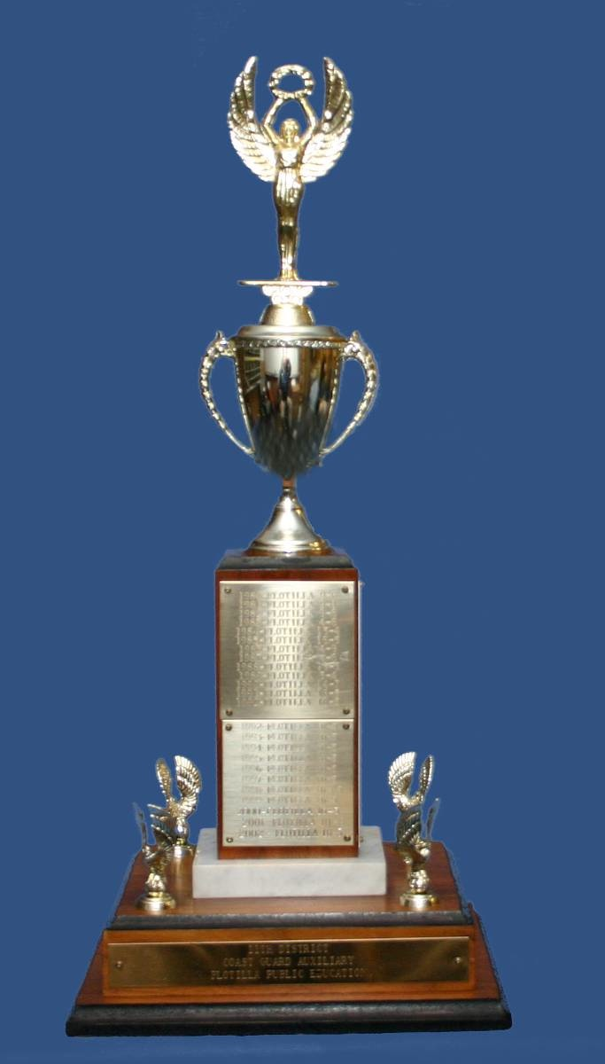
FLOTILLA MOST ACTIVE
IN VESSEL EXAMINATIONS
POWER SQUADRON AWARD
FLOTILLA 07-03
The Islands

Slide 15
INDIVIDUAL MOST ACTIVE
IN POWERED VESSEL EXAMS
GARY HOOPER
FLOTILLA 06-06
North Orange County

Slide 16
INDIVIDUAL MOST ACTIVE
IN SELF-PROPELLED VESSEL EXAMS
AARON TODD
FLOTILLA 07-03
The Islands

Slide 17
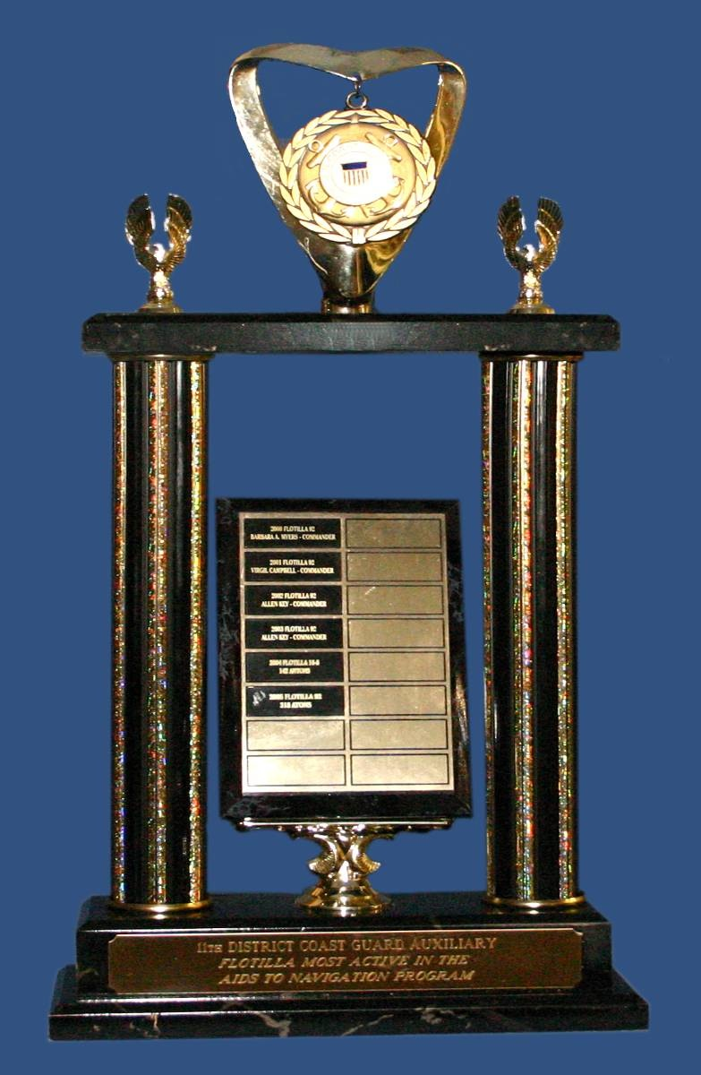
FLOTILLA MOST ACTIVE
IN NAVIGATION
SYSTEMS PROGRAM
FLOTILLA 09-06
Central Las Vegas

Slide 18
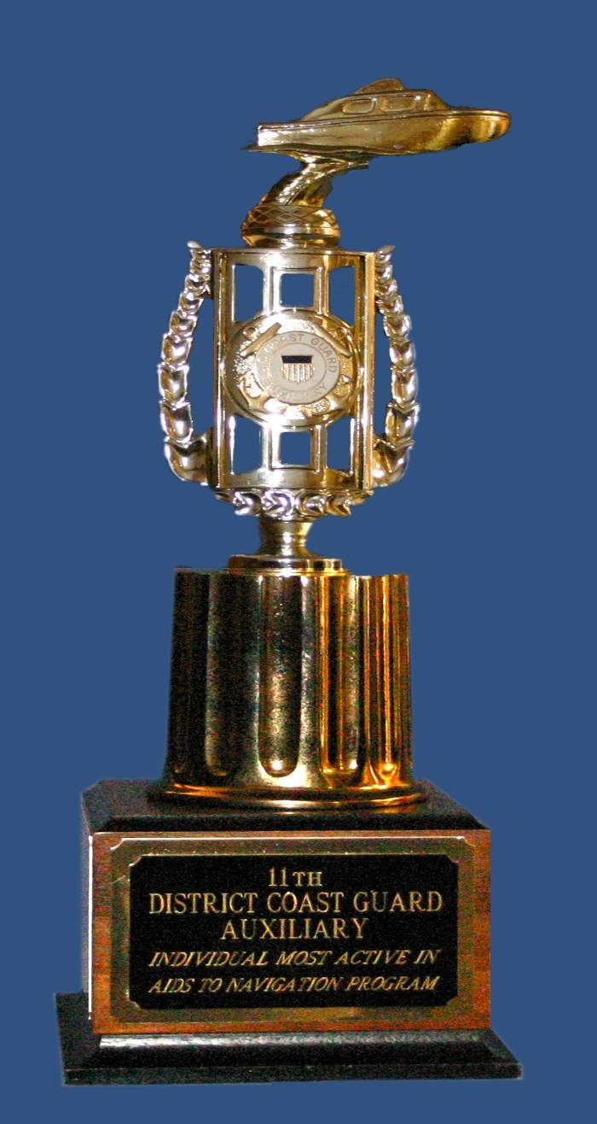
INDIVIDUAL MOST
ACTIVE IN
NAVIGATION SYSTEMS
PROGRAM
THOMAS PELOSI
FLOTILLA 09-06
Central Las Vegas

Slide 19
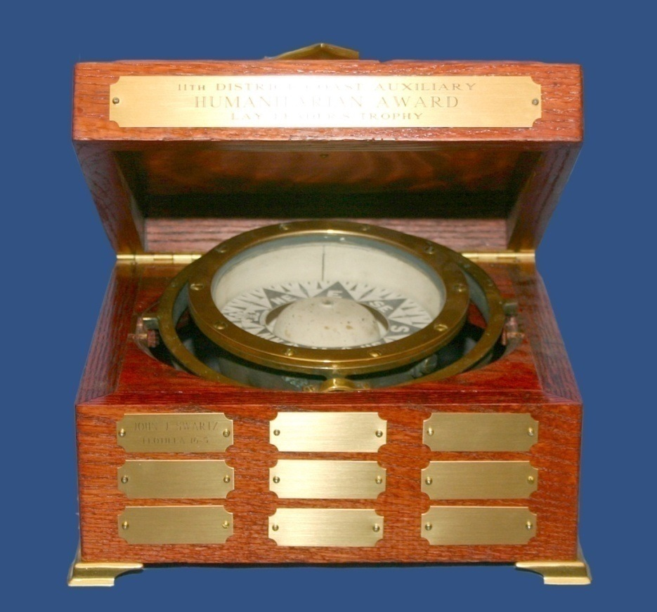
LAY LEADER’S TROPHY
CHRIS HARSHFIELD
FLOTILLA 09-06
Central Las Vegas

Slide 20
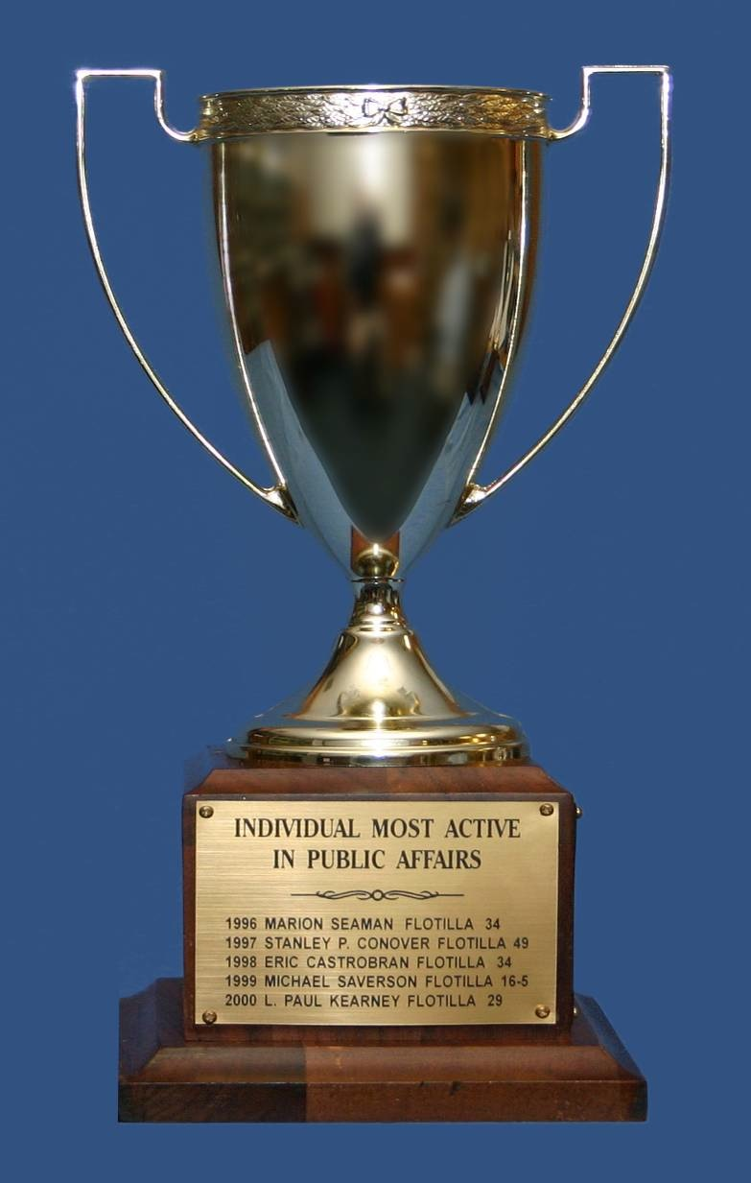
INDIVIDUAL MOST ACTIVE
IN PUBLIC AFFAIRS
KRISTOFFER HALVORSON
FLOTILLA 10-03
Arizona Band

Slide 21
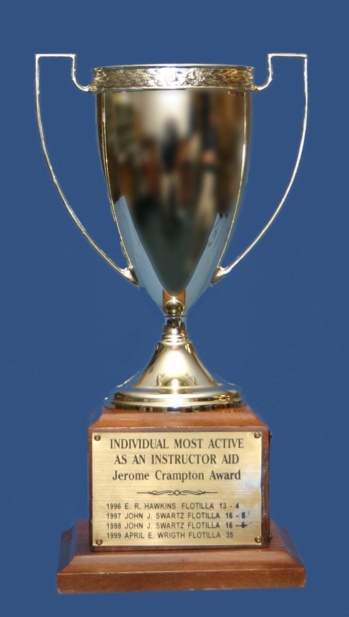
INDIVIDUAL MOST
ACTIVE AS AN
INSTRUCTOR AIDE- PUBLIC EDUCATION
JEROME CRAMPTON AWARD
MARK HILSTAD
FLOTILLA 06-01
Newport Harbor

Slide 22
INDIVIDUAL MOST
ACTIVE AS AN
INSTRUCTOR AIDE- MEMBER TRAINING
LESLIE PELOSI
Flotilla 09-06-001
Bullhead City Detachment

Slide 23
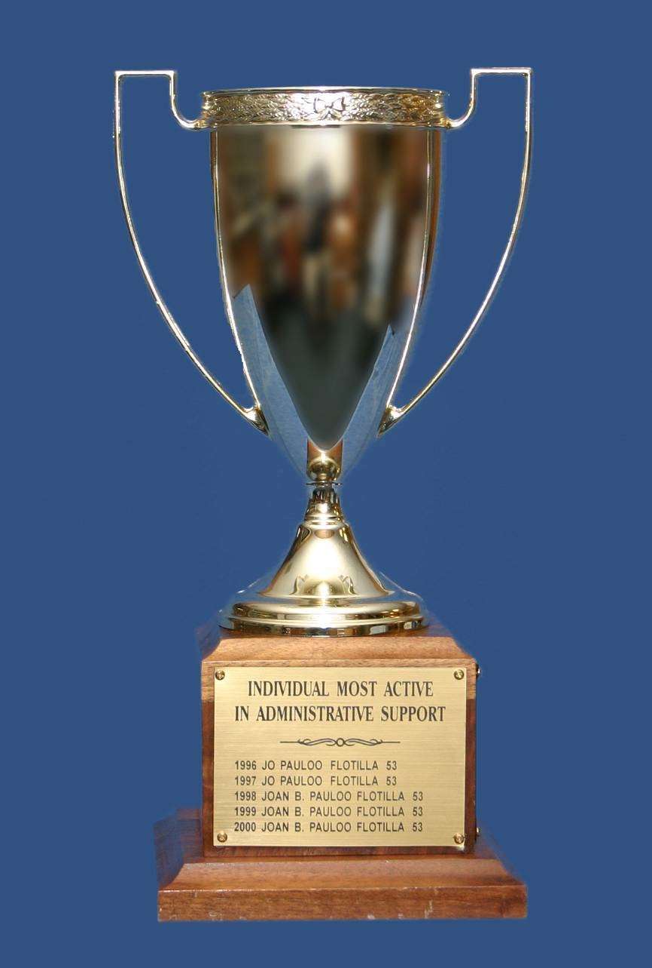
INDIVIDUAL MOST ACTIVE
IN COAST GUARD
ADMINISTRATIVE
SUPPORT MISSIONS
SUSAN GOULD
FLOTILLA 01-01
San Diego Harbor

Slide 24
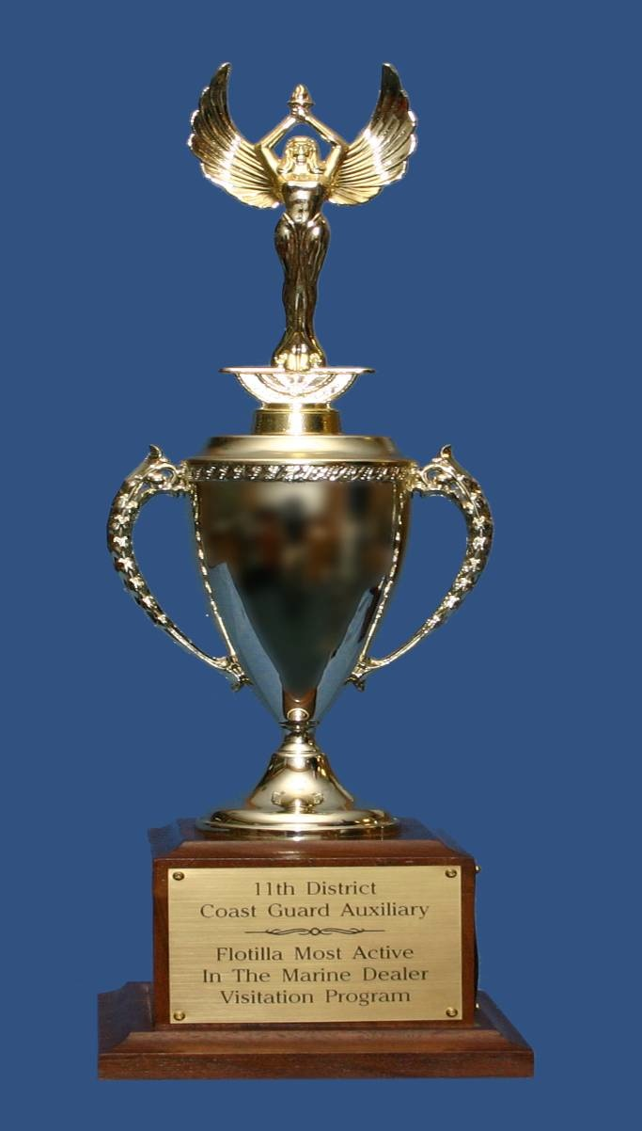
FLOTILLA MOST ACTIVE
IN RECREATIONAL
BOATING SAFETY
VISITATION PROGRAM
FLOTILLA 06-03
Orange Coast

Slide 25
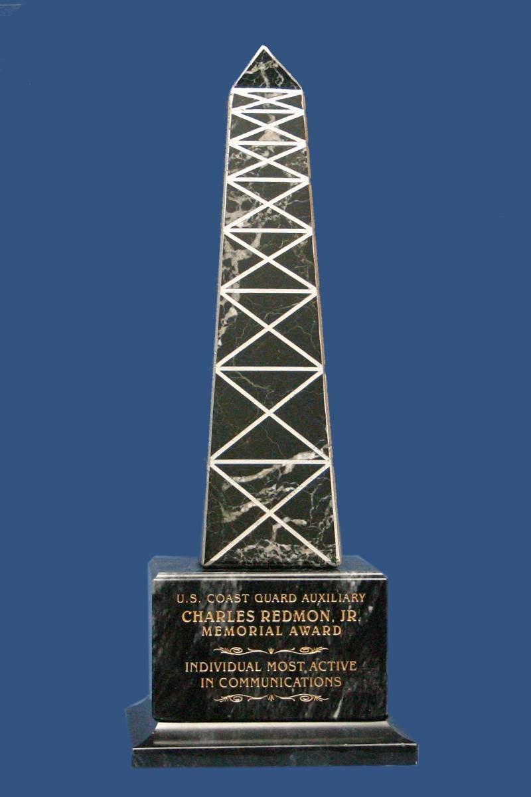
INDIVIDUAL MOST ACTIVE
IN COMMUNICATIONS
CHARLES REDMON JR.
MEMORIAL AWARD
MARK HILSTAD
FLOTILLA 06-01
Newport Harbor

Slide 26
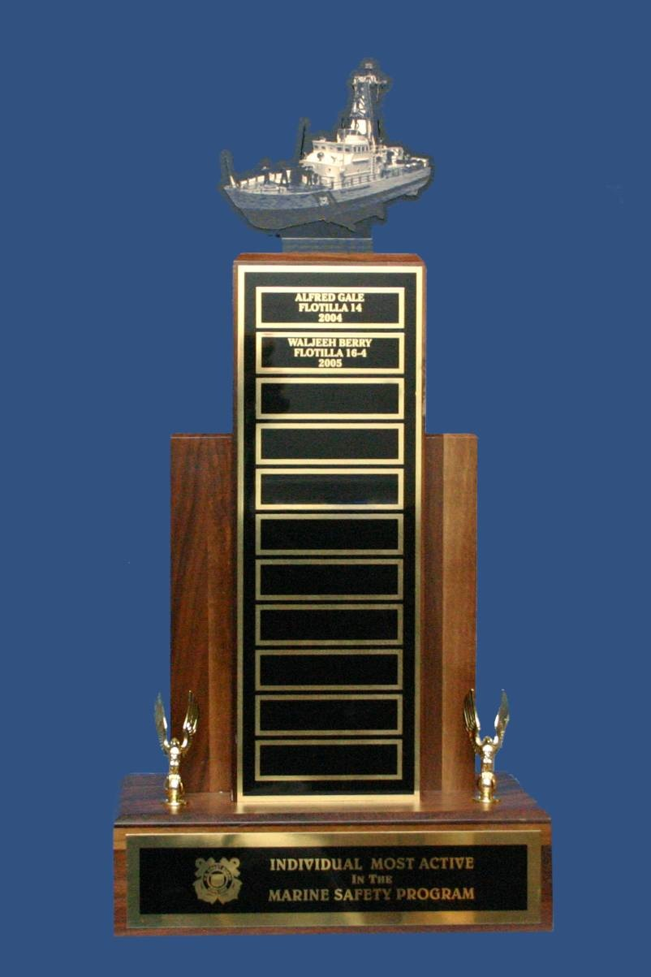
INDIVIDUAL MOST ACTIVE
IN MARINE SAFETY
PROGRAM
SANDRA LINDSEY
FLOTILLA 06-02
Huntington Harbor

Slide 27
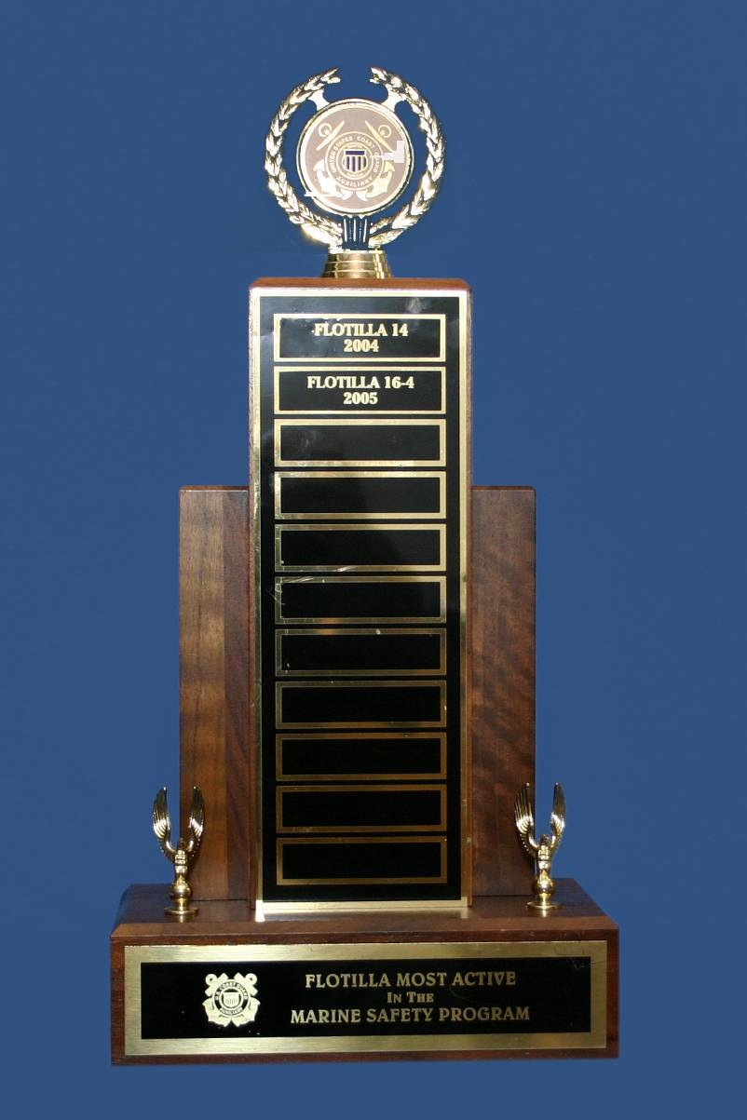
FLOTILLA MOST ACTIVE
IN MARINE SAFETY
PROGRAM
FLOTILLA 06-02
Huntington Harbor

Slide 28
BEST FLOTILLA WEBSITE
DIVISION 1
San Diego Area

Slide 29
MEMBER MOST ACTIVE IN
LEADERSHIP SUPPORT (99A)
MICHAEL BOZARTH
FLOTILLA 06-02
Huntington Harbor

Slide 30
MEMBER MOST ACTIVE IN
RECREATIONAL BOATING
SAFETY SUPPORT (99B)
GARRY NELSON
FLOTILLA 06-08
Dana Point

Slide 31
MEMBER MOST ACTIVE IN
MARINE SAFETY (99C)
DANIEL DIRKES
FLOTILLA 01-09
Coronado

Slide 32
MEMBER MOST ACTIVE IN
TRAINING SUPPORT (99D)
STEPHEN CSIK
FLOTILLA 12-05
Beach Cities

Slide 33
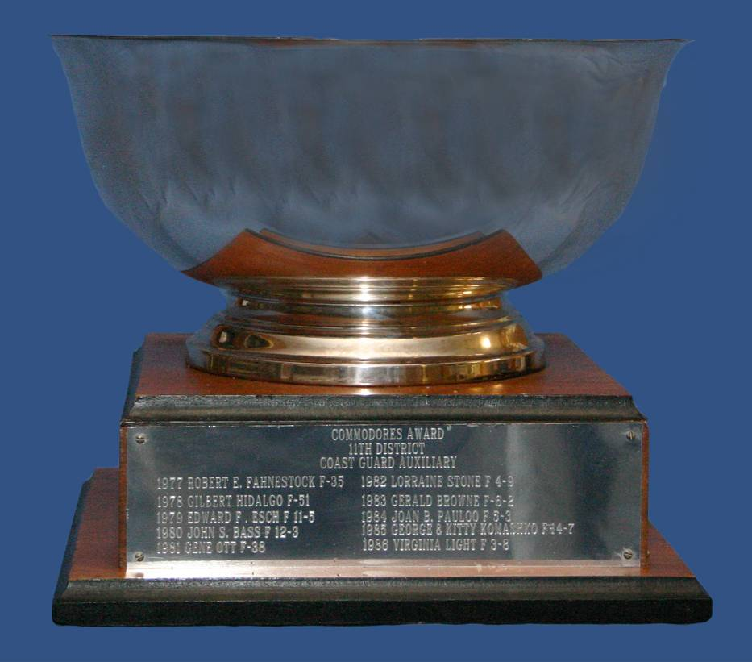
DISTRICT COMMODORE'S AWARD
LESLIE PELOSI
114-09-06-001
Bullhead City Detachment

Slide 34
UNITED STATES COAST GUARD AUXILIARY
D11S AUXILIARY & SECTOR AWARDS

Slide 35
MERITORIOUS TEAM COMMENDATION
AUX THRIFT MATERIALS
Desiree De Liser
Rick Weiss
John Carrol

Slide 36
MERITORIOUS TEAM COMMENDATION
LAKE PIRU PWC TEAM
Linnea Haas
Martin Atwell
Herb Haas

Slide 37
MERITORIOUS TEAM COMMENDATION
DIV 04 MEMORIAL DAY FLAG PLACEMENT TEAM
Que Pho | Don Roof
Orrei Barasch | Barry Chapman
Ralph Casale | Robert Hickey
Linda Malkas | Elham Partovi
Payam Naffas | Marijan Vucic
Richard Vogel

Slide 38
MERITORIOUS TEAM COMMENDATION
2023 MEMORIAL DAY COMREL TEAM
Jenny Goode | Kris Halvorson | Jon Jeffrey
Kevin Brown | John Zink | Elliot Prichard
Nikki White | Pam Wolfe | Al Yarusso
Lyle Lamb | Paul Langstroth | Dan Hay
Sydney Hay | Jacqueline Pauly | Michael Farrar
Jack Pauly | Mike Doyle | Doug Houle

Slide 39
MERITORIOUS TEAM COMMENDATION
2023 MEMORIAL MARKER CEREMONY
Tom Jacobsmeyer | Wayne Palmer | Pat Swope
June Esparza | Dave Esparza | Leslie Pelosi
Tom Pelosi | Rob Tanner | Kris Halvorson
Paul Langstroth | Nikki White | Desiree De Liser
Michael Bozarth | Rod Donohoo | John Olsen
Bill Scholz | Ann Evans | Ray Evans

Slide 40
MERITORIOUS TEAM COMMENDATION
MEMORIAL MARKER CEREMONY
(Cont.)
Mark Hilstad | Ed Little | Mark Forster
Rachel Fain | Emily Scholz | Robert McKoy
Jackson Whitaker | William Shakespeare

Slide 41
MERITORIOUS TEAM COMMENDATION
2023 FLEET WEEK TEAM
Christopher Aaron | Steven Codraro | William Frantz
George Glover | Mark Goodman | Susan Gould
Glenn Hakius | Douglas Hawkins | Randy Houk
Edward Lai | Martha Shaw | Lawrence Shushan
Diane VanDruff | Russ Venti | Marlene Williams
Catherine Yslas | Robert Yslas | Christopher Cervantes

Slide 42
MERITORIOUS TEAM COMMENDATION
2023 MIRAMAR AIR SHOW
Glenn Arrant | Erik Atkisson | Scott Behar
Raul Berrios | James Carmody | William Calderwood
Steven Codraro | Carey Davis | Angela Ginn
George Glover | Mark Goodman | Faith Granada
Glenn Hakius | Edward Lai | Ian Lazarus
Ron Mealey | Martin Mendoza | Anthony Milano
Chris Milano | Peter Rosen | Any Rowlands

Slide 43
MERITORIOUS TEAM COMMENDATION
2023 MIRAMAR AIR SHOW
(Cont’d)
James Scoffin | Lawrence Shushan | Paul Stein
Diane Vandruff | Randy Wesson | Marlene Williams
Catherine Yslas | Robert Yslas

Slide 44
MERITORIOUS TEAM COMMENDATION
DIV 10 VFW EVENT TEAM
Lyle Lamb | June Esparza | Don McDowell
Paul Swietek | Mark Walker | Michael Doyle
Jack Pauly | Joseph Cannon | George Hornbeck
Gary Taylor

Slide 45
MERITORIOUS TEAM COMMENDATION
HOLIDAY TOY DRIVE
Guy Heaton | Paul Saba | Mark Forster
Wayne Palmer | Rudy Lopez | John Durrer

Slide 46
MERITORIOUS TEAM COMMENDATION
2023 ST PATRICK’S DAY PARADE
Michael Brodey | Rudy Cortez | Dave Vadbunker
Robert Hamming | Rafael Longo | Patrick Newburn
Kathleen Roos

Slide 47
MERITORIOUS TEAM COMMENDATION
2023 OPERATIONS WORKSHOP
Ron Mealey | Jim Pearson | Herb Haas
Linnea Haas | Robert Arovas | Dave Vadbunker
Thomas Pelosi | Leslie Pelosi | Abboud Bedro
June Esparza | Diane Lee | Dave Esparza
Ben Palmer | Al Verdi | Bob McKoy

Slide 48
MERITORIOUS TEAM COMMENDATION
BASS PRO SHOP RBS OUTREACH TEAM
Nigel Haynes | David Lieberman | Jerry Myers
Wayne Palmer | Mark Forster | Justin Peck
Mike Mendoza | Aaron Ellis | Guy Heaton
Paul Saba | Forrest McClendon | Gene Schultz

Slide 49
MERITORIOUS TEAM COMMENDATION
DIRECTOR’S OFFICE ADMIN TEAM
Desiree De Liser | William Shakespeare
Steve Sherman | Joe Benton
Robert McKoy | Lori Barfield
Hilberto Gonzalez | Rudy Lopez
Rick Weiss | Wayne Palmer
John Carrol

Slide 50
UNITED STATES COAST GUARD AUXILIARY
D11S 2024 AWARD WINNERS

